Slide 1

CAUVERY INSTITUTE OF TECHNOLOGY, MANDYA MINI PROJECT PRESENTATION on “SINKING SHIP”
PRESENTED BY: UNDER THE GUIDENCE OF:
Sumanth B S (4CA21CS100) Prof. Rajini K C
Shiva Prasad R (4CA21CS090) Asst. Professor
Rinu Priya S (4CA21CS080) Dept. of CSE, CIT Mandya
Sahana B C (4CA21CS082)

Slide 2
Contents
Introduction
Objectives
The power of OpenGL
System requirements
Implementation details
Instructions to move the Ship
Snapshots

Slide 3


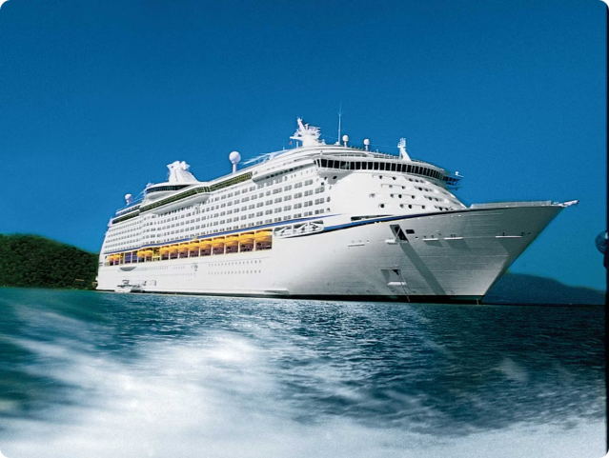
INTRODUCTION
The "Sinking Ship" project is an engaging computer graphics simulation developed using OpenGL. This interactive experience allows users to control a ship's journey, witness a collision with an obstacle, and observe the subsequent sinking process. By leveraging the power of OpenGL, the simulation provides a real-time, visually captivating representation of various computer graphics concepts and principles.

Slide 4
Objectives:
1
Visually Appealing Simulation
The primary objective is to create a visually stunning and functionally accurate simulation of a ship sinking after colliding with a rock obstacle.
2
Demonstrating OpenGL Proficiency
The project aims to showcase the team's proficiency in utilizing OpenGL and GLUT libraries for 2D graphics and animations.
3
Implementing Key Concepts
The simulation allows for the implementation of computer graphics concepts such as geometric transformations, color manipulation, and animation timing.

Slide 5
The Power of OpenGL
OpenGL (Open Graphics Library) is a standard specification that defines a cross-language, cross-platform API for creating 2D and 3D computer graphics.
OpenGL offers a comprehensive set of functions and commands for drawing primitives, manipulating colors, and applying transformations.
It abstracts the complexities of hardware-specific implementations, allowing programmers to focus on the core graphics logic.

Slide 6
System Requirements
Hardware Specifications
Software Dependencies
Processor: Intel Core i5
RAM: 1GB or more
HardDisk: 40 GB to 80GB
Operating System: windows 7 or more
Programming language: C++
Graphics Library: GL/glut.h
API: OpenGL 2.0

Slide 7
Implementation details
1
Ship Simulation
Implemented using OpenGL
Ship movement controlled by keyboard inputs
Adjustable speed and direction
Compartment system with variable number of sections
Graphics
Ship, water, and rock drawn using OpenGL primitives
Bezier curves used for water animation
Sky background with moving clouds
2

Slide 8



Water Animation
The simulation utilizes Bezier curves to create a dynamic and visually appealing water animation, building upon established techniques in computer graphics for simulating ocean waves and fluid motion.
Collision Detection
Efficient collision detection algorithms are implemented to ensure accurate interactions between the ship and the rock obstacle, a crucial component in creating a realistic and responsive simulation.
User Interaction
The project prioritizes user engagement by providing a direct manipulation interface, allowing users to control the ship's movement, speed, and other properties, creating an immersive and interactive experience.

Slide 9

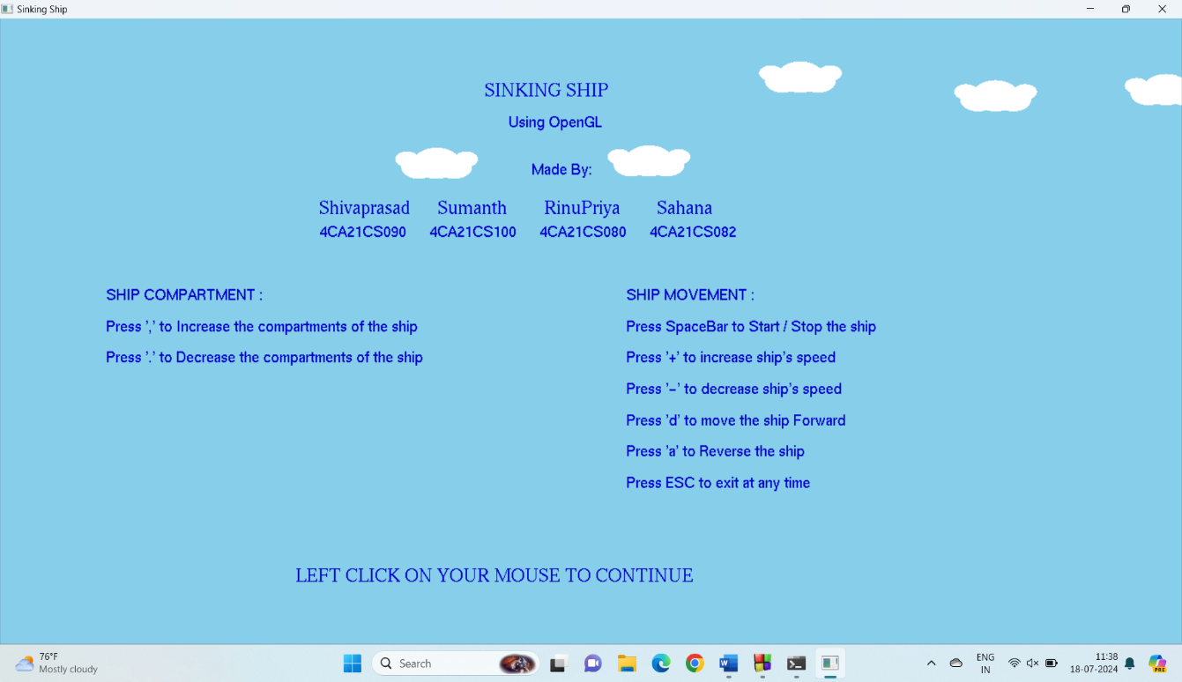
Instructions to move the Ship
.

Slide 10


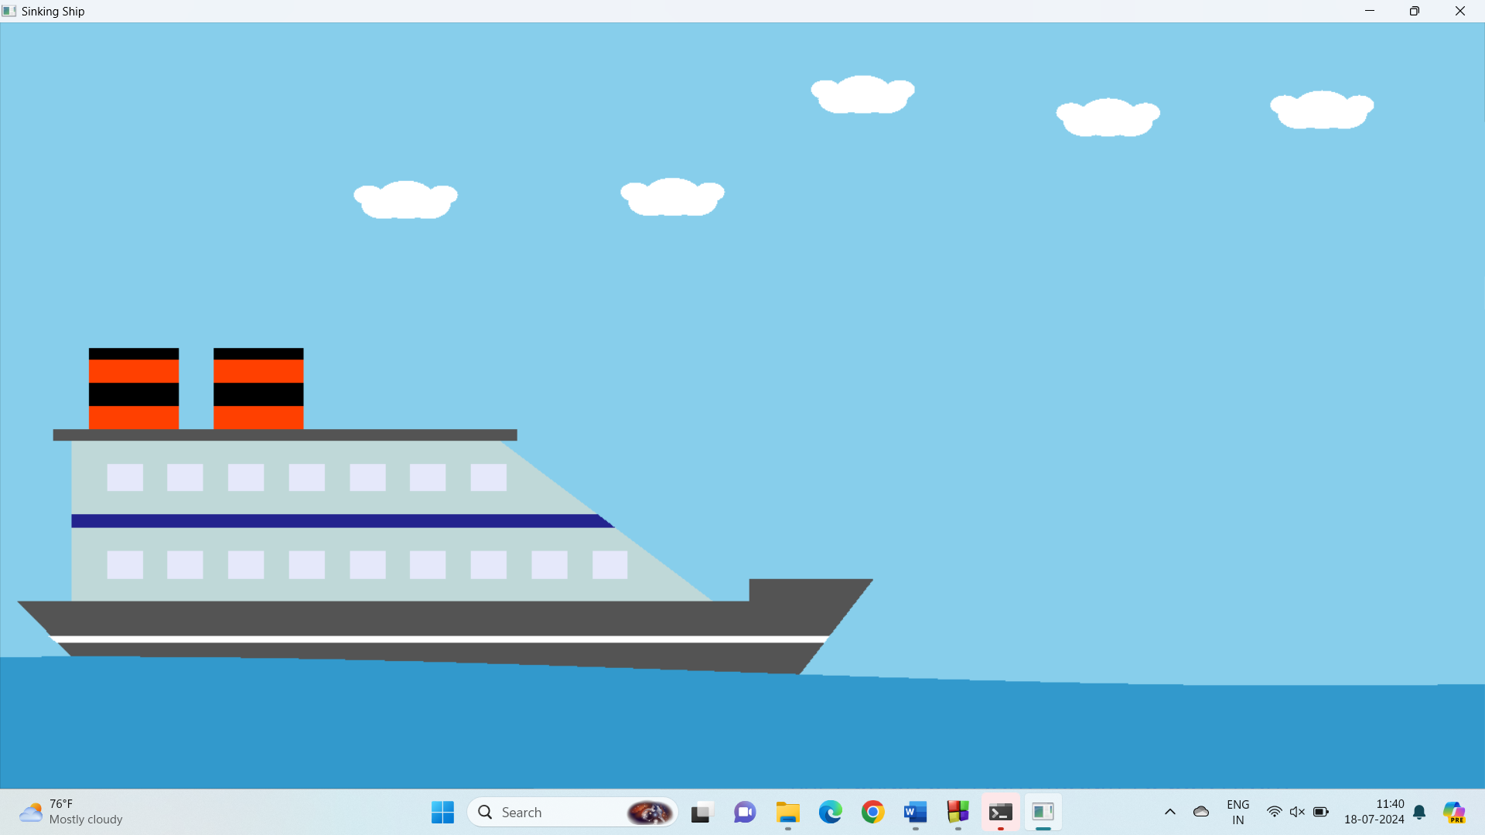
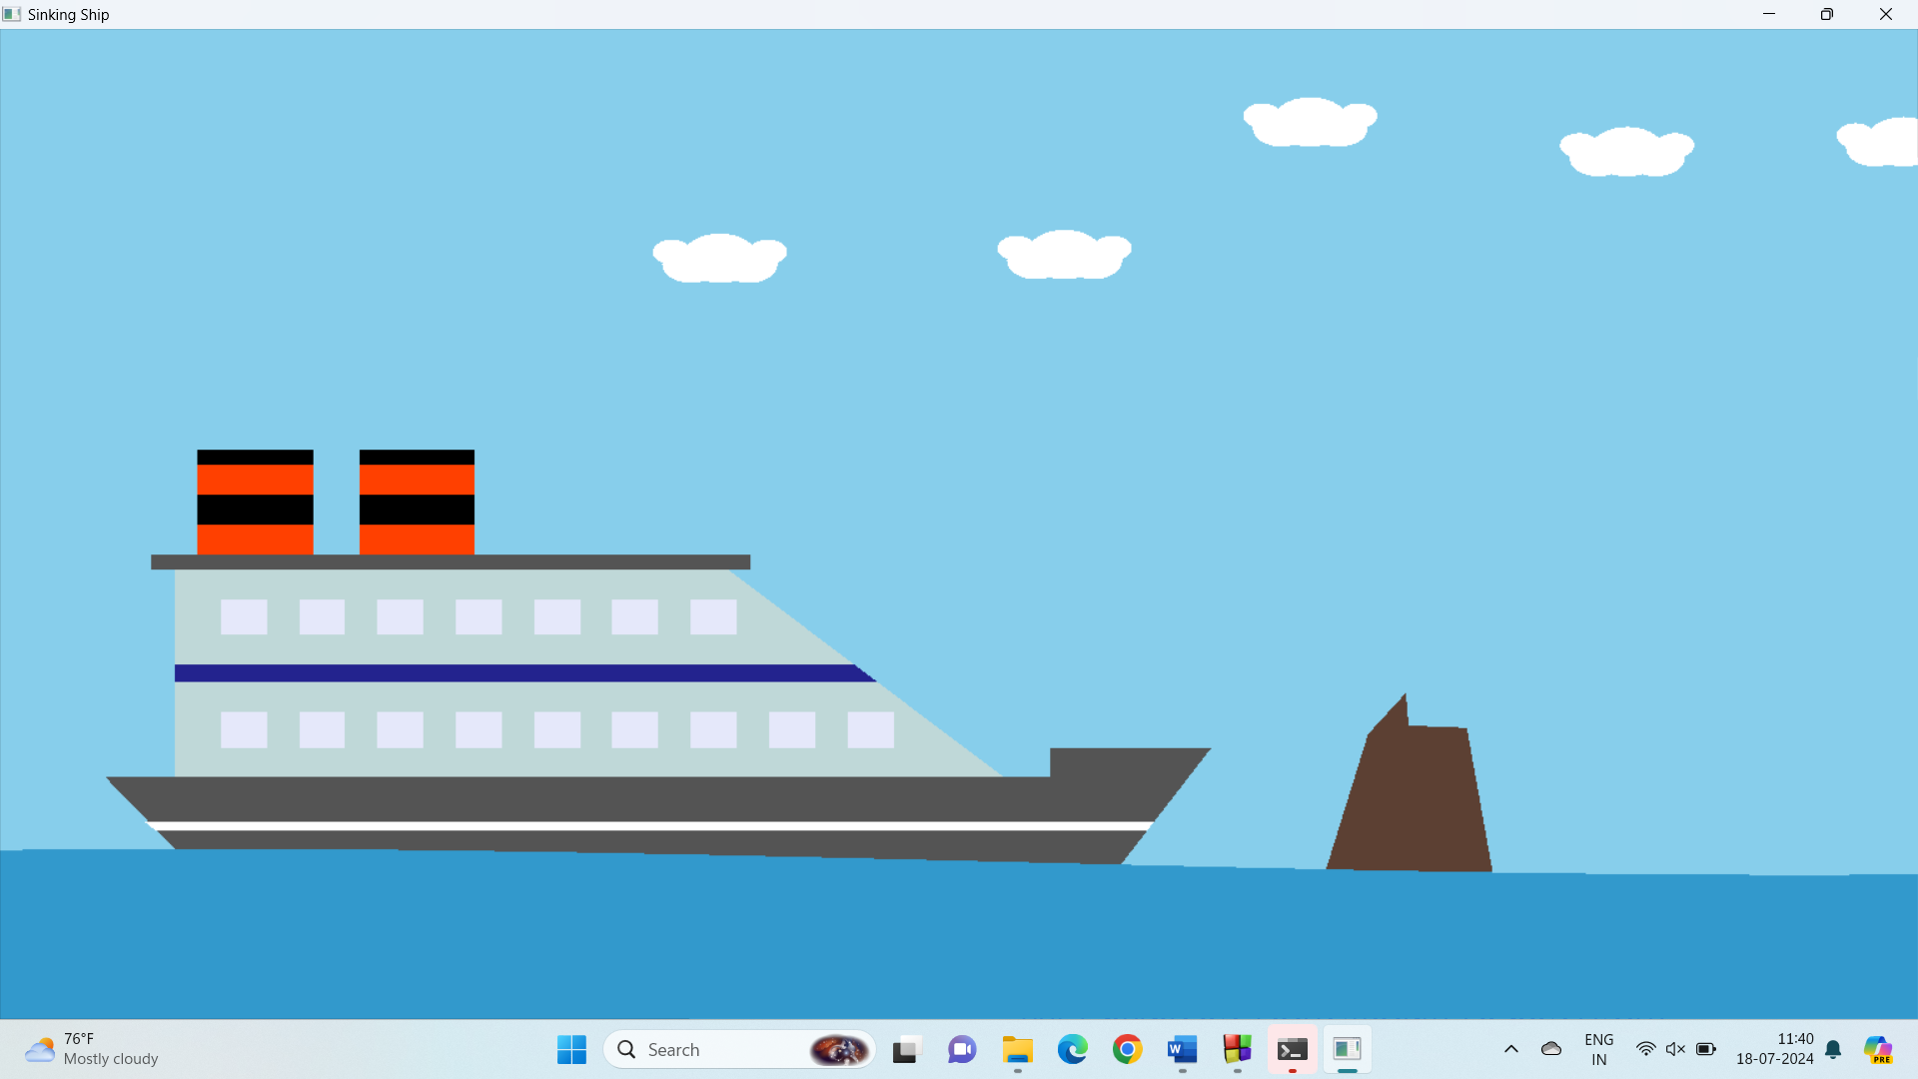
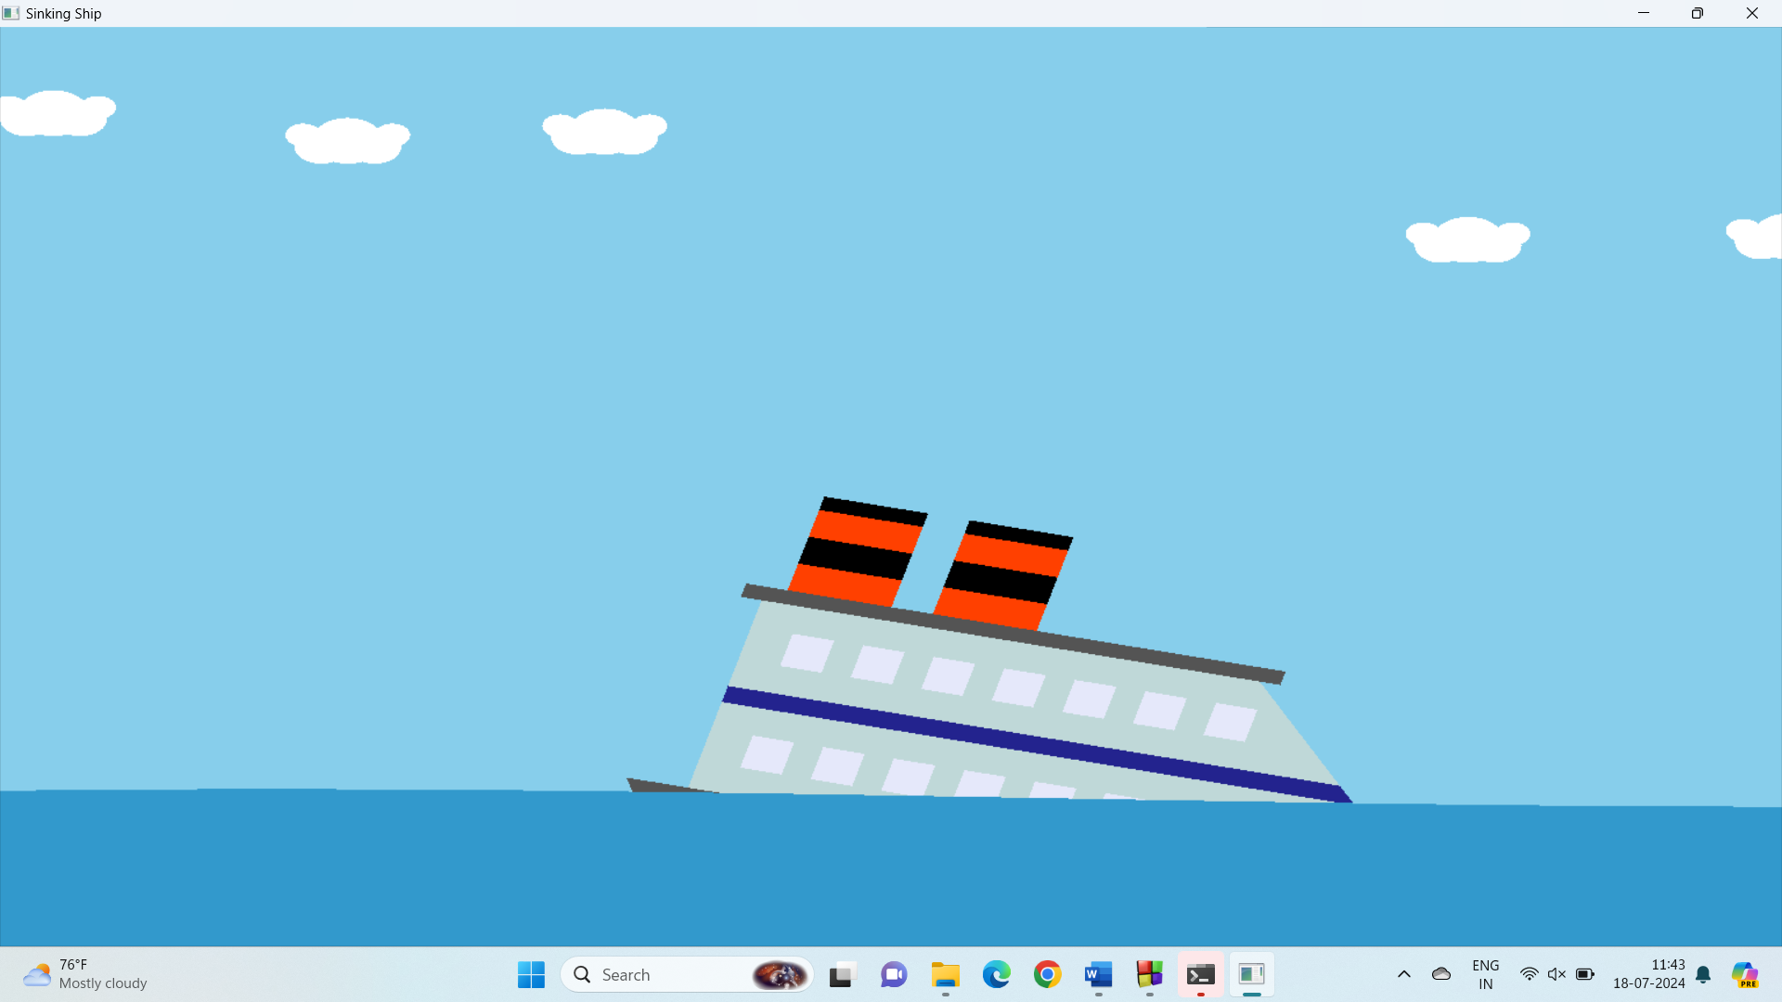
Snapshots
Ship Sailing
Ship Approaching Obstacle
Ship Sinking
The simulation begins with the ship sailing smoothly across the water, allowing users to control its movement and observe the dynamic water animation.
As the ship approaches the rock obstacle, the simulation displays the ship in a state of impending collision, preparing the user for the upcoming sinking sequence.
Upon collision with the rock, the simulation depicts the ship breaking apart and sinking, with the user witnessing the consequences of the impact and the subsequent sinking process.

Slide 11


